Slide 1
Lecture 8
8086 Microprocessor
Pins and Signals

Slide 2
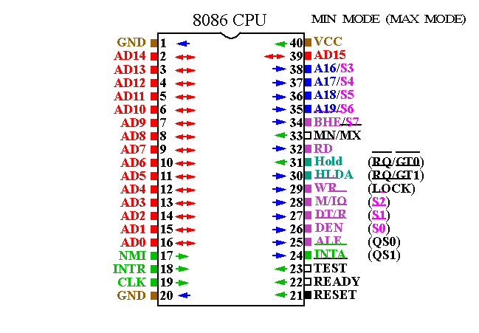

Slide 3
Modes of 8086
8086 pins and signals can be configured in two modes by MN/MX input pin
  Minimum mode (MN/MX = 1): support single processor systems using few devices that use system bus.
  Maximum mode (MN/MX = 0): support multiprocessor systems and Intel 8288 bus controller is added to the 8086 to provide bus controls and compatibility with multi bus architecture

Slide 4
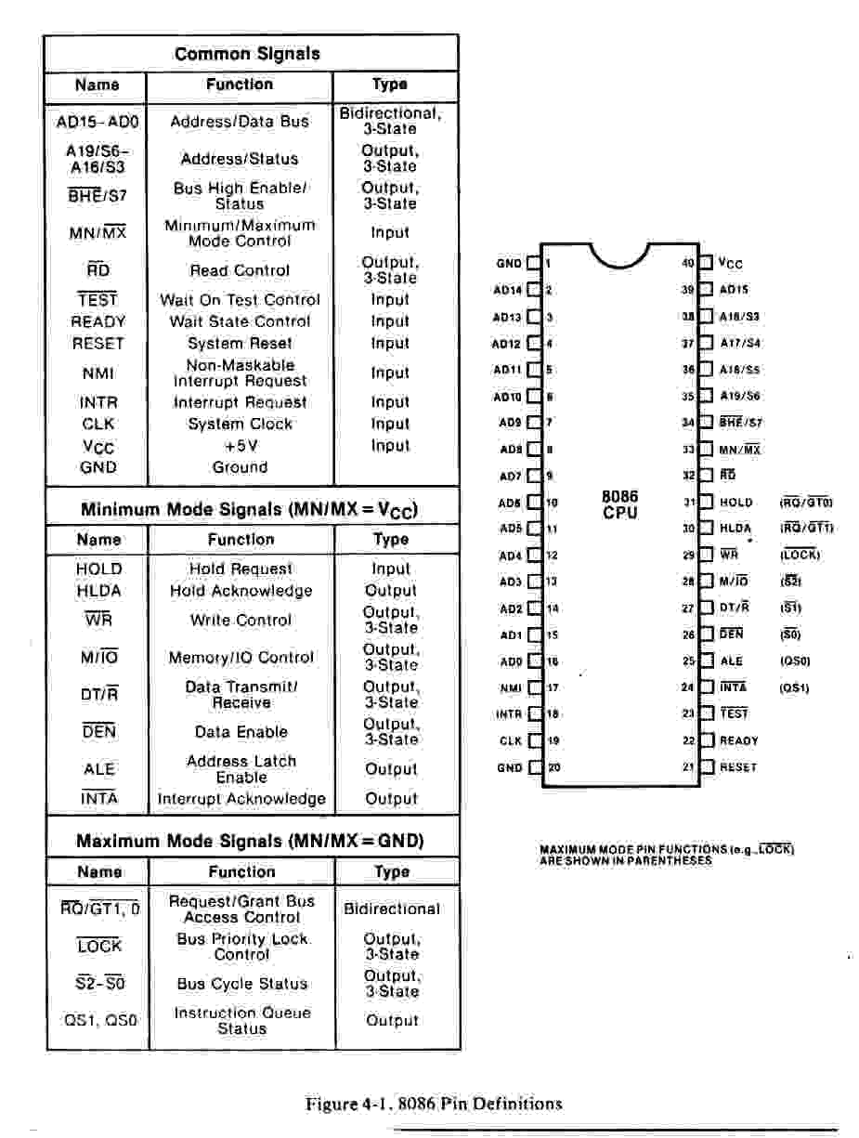
8086 Microprocessor

Slide 5
Common Signals (Same for minimum and maximum mode)
AD₀-AD₁₅: Multiplexed Address and data lines. Act as lower 16 bit address lines during 1st clock cycle, and act as 16 bit data lines for remaining clock cycles of the instruction. time with 16 bit data lines.
A₁₆/S₃, A₁₇/S₄, A₁₈/S₅, A₁₉/S₆:Upper 4 bits of address lines are multiplexed with four status lines, during the 1st clock cycle of a bus cycle these four lines and AD₀-AD₁₅ give the 20 bit address. For other clock cycles these four lines function as follows:
  A₁₆/S₃, A₁₇/S₄: Act as S₃, S₄. Shows the segment register involved for physical address calculation
  S₄ S₃
  0 0 Extra segment
  0 1 Stack segment
  1 0 Code or no segment
  1 1 Data segment
  A₁₈/S₅: Indicates the status of interrupt flag (IF)
  A₁₉/S₆:Indicate that 8086 is currently using the system bus. During Hold acknowledge clock period , this pin is tri-stated and allows another device to take control of the system bus.

Slide 6
Common Signals (Same for minimum and maximum mode)
BHE / S7(Bus High Enable/Status 7): During the 1st clock cycle 8086 outputs low on this pin to transfer data in AD₁₅ to AD₈ of the data bus. During all other clock cycles this pin is used as S₇ and 8086 maintains the output level of BHE on this pin.
RD: 8086 outputs low on this line when reading data from memory or an I/O location.
TEST: Input pin. Used by WAIT instruction. After execution of WAIT instruction 8086 remains in wait state until a LOW is input on this pin.
INTR: Input pin. Used by external devices to interrupt the microprocessor. INTR must be held high level until recognized by the processor to generate an interrupt.

Slide 7
Common Signals (Same for minimum and maximum mode)
NMI: input pin. Nonmaskable interrupt input activated by a leading edge and must be active for two clock cycled to be recognized. Normally used for power failures.
RESET: Input pin. Used to reset the system. The signal must be held high for four clock cycles to be recognized by the processor. It causes 8086 to initialize DS, SS, ES, IP and flags to all zeros and CS to FFFFH.
READY: Input pin. Slow devices input a low on this line for sufficient time to transfer data and then input a high on this pin to activate the processor.

Slide 8
Minimum mode Signals
DT/R (Data transmit / Receive): Output pin. 8086 outputs high to transmit data and outputs low to receive data through the transceiver (8286/8287)
DEN (Data Enable): Output pin. 8086 outputs low on this pin to enable transceiver.
ALE (Address latch Enable): Output pin. Used to demultiplex AD₁₅ to AD₀ into A₁₅ - A₀ and D₁₅ -D₀ when high to low occurs on this pin.
M/IO (Memory / Input output): Output pin. 8086 outputs high on this pin during memory access and outputs low on this pin during input/output operation.
WR: Output pin. 8086 outputs low on this pin to indicate the memory or I/O write operation.
INTA (Interrupt acknowledge): 8086 outputs low to acknowledge the interrupt request on the INTR pin.

Slide 9
Minimum mode Signals
HOLD : input pin. A HIGH on this pin indicates that another device (Ex. DMA controller) is requesting to take over the system bus.
HLDA (Hold acknowledge): Output pin. 8086 outputs high on this pin to acknowledge the HOLD request.
CLK (Clock): Input pin. Provides the basic timing for the 8086 and bus controller. Clock signal come from a chip (8284).

Slide 10
Minimum mode Signals
HOLD : input pin. A HIGH on this pin indicates that another device (Ex. DMA controller) is requesting to take over the system bus.
HLDA (Hold acknowledge): Output pin. 8086 outputs high on this pin to acknowledge the HOLD request.
CLK (Clock): Input pin. Provides the basic timing for the 8086 and bus controller. Clock signal come from a chip (8284).

